Slide 1

The Machine Learning Process
Python 101 – Object Oriented Programming(OOP)
Sathish Ravichandran

Slide 2

Object Oriented Programming
So far, we have written our program using data and functions, this is called procedural programming.
Object oriented programming wraps the properties and functionalities inside a class. When we want to use the class, we create object of that class.
Properties
Make
Model
Color
Year
Price
Methods
Start
Drive
Park
Stop

Slide 3


Car Class
Properties
Make
Model
Color
Year
Price
Methods
Start
Drive
Park
Stop
Properties | Value
Make | Lamborghini
Model | Aventador
Color | Orange
Year | 2017
Price | CA$450,000
Methods
Start
Drive
Park
Stop
Properties | Value
Make | Tesla
Model | Model S
Color | Red
Year | 2018
Price | CA$105,300
Methods
Start
Drive
Park
Stop

Slide 4
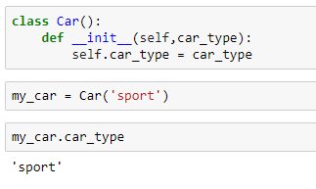
Car Class - Example
Simple car class with one attribute
Car #Class
my_car #object
Calling object attribute
Notes:
class Car():
def __init__(this,what_car):
this.car_type = what_car
my_car = Car('sport’)
my_car.car_type

Slide 5
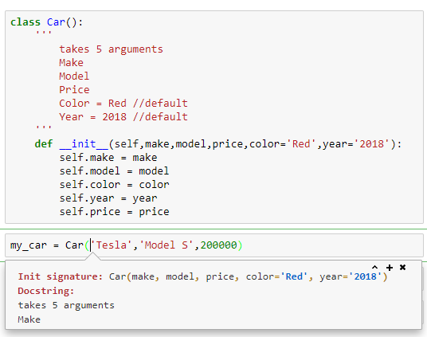
Car Class - More attributes
Docstring
Shift+Tab
Notes:
class Car():
'''
takes 5 arguments
Make
Model
Price
Color = Red //default
Year = 2018 //default
'''
def __init__(self,make,model,price,color='Red',year='2018'):
self.make = make
self.model = model
self.color = color
self.year = year
self.price = price
my_car = Car('Tesla','Model S',200000)
my_car.model

Slide 6
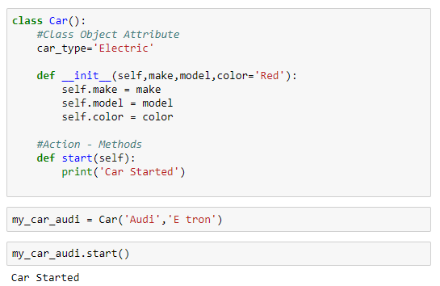
Class - Methods
Methods are functions defined inside the class
Class Method
Method Call
Notes:
class Car():
#Class Object Attribute
car_type='Electric'
def __init__(self,make,model,color='Red'):
self.make = make
self.model = model
self.color = color
#Action - Methods
def start(self):
print('Car Started’)
my_car_audi = Car('Audi','E tron’)
my_car_audi.start()

Slide 7
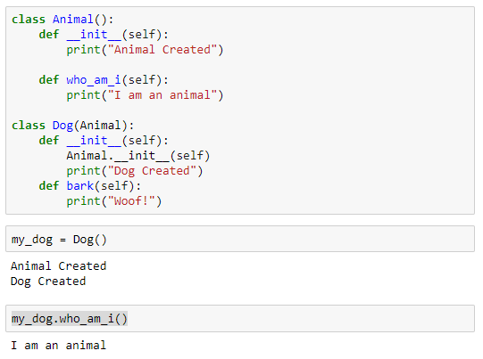




Inheritance
Inheritance allows us to define a class that inherits all the methods and properties from another class.
Base Class
Derived Class
Notes:
class Animal():
def __init__(self):
print("Animal Created")
def who_am_i(self):
print("I am an animal")
class Dog(Animal):
def __init__(self):
Animal.__init__(self)
print("Dog Created")
def bark(self):
print("Woof!")
my_dog = Dog()
my_dog.who_am_i()

Slide 8
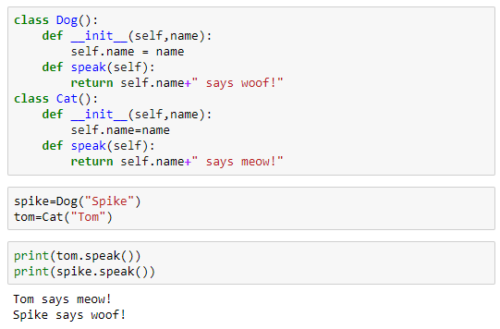
Polymorphism
Polymorphism is the ability of an object to take on many forms.
Two class contains same method name
Notes:
#class
class Dog():
def __init__(self,name):
self.name = name
def speak(self):
return self.name+" says woof!"
class Cat():
def __init__(self,name):
self.name=name
def speak(self):
return self.name+" says meow!“
#object
spike=Dog("Spike")
tom=Cat("Tom")
#Method call
print(tom.speak())
print(spike.speak())

Slide 9
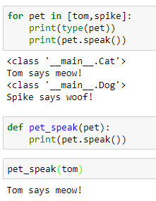
Polymorphism
Polymorphism is the ability of an object to take on many forms.
Pet.speak() does not know which method it is going to call
Similarly pet_speak() will work depends on the object that is passed to it
Notes:
for pet in [tom,spike]:
print(type(pet))
print(pet.speak())
def pet_speak(pet):
print(pet.speak())
pet_speak(tom)

Slide 10
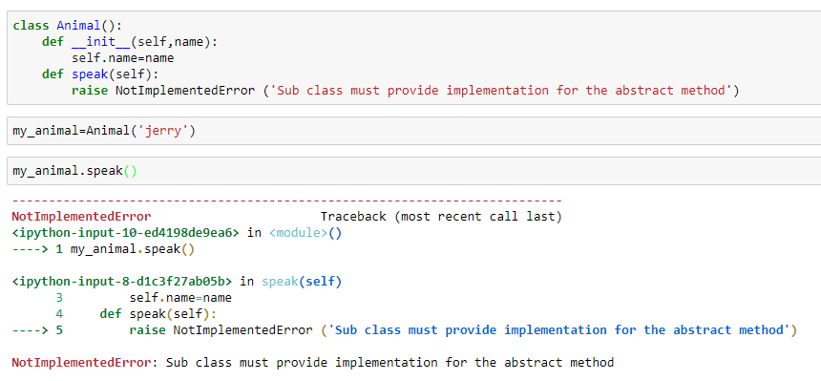
Abstarct class
Abstract classes may not be instantiated, and require subclasses to provide implementations for the abstract methods
An abstract method is a method that is declared but contains no implementation.
Notes:
class Animal():
def __init__(self,name):
self.name=name
def speak(self):
raise NotImplementedError ('Sub class must provide implementation for the abstract method’)
my_animal=Animal('jerry’)
my_animal.speak()

Slide 11
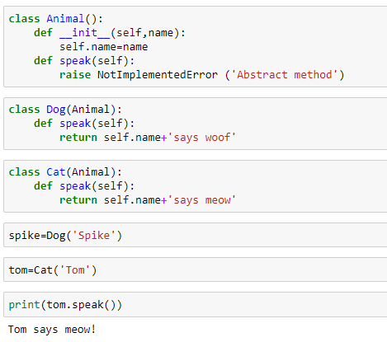
Implementing abstarct class
Abstract class (base class)
Derived class
Notes:
class Animal():
def __init__(self,name):
self.name=name
def speak(self):
raise NotImplementedError ('Sub class must provide implementation for the abstract method’)
class Cat(Animal):
def speak(self):
return self.name+'says meow’
class Dog(Animal):
def speak(self):
return self.name+'says woof’
spike=Dog('Spike’)
tom=Cat('Tom’)
print(tom.speak())

Slide 12
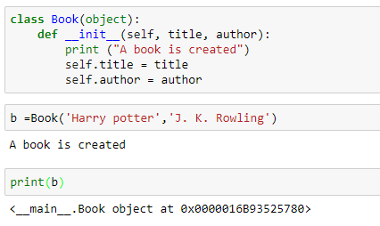

Special Method
Why the print(b) does not return the object attributes?
Notes:
class Book(object):
def __init__(self, title, author):
print ("A book is created")
self.title = title
self.author = author
b =Book('Harry potter','J. K. Rowling’)
print(b)

Slide 13
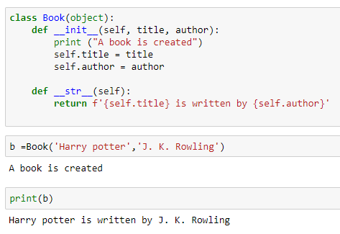
Special Method
<__main__.Book object at 0x0000016B93525780> is the string representation of the object
This special method allows us to provide the string representation of the object
Special methods are defined by their use of underscores. They allow us to use Python specific functions on objects created through our class.
Notes:
class Book(object):
def __init__(self, title, author):
print ("A book is created")
self.title = title
self.author = author
def __str__(self):
return f'{self.title} is written by {self.author}’
b =Book('Harry potter','J. K. Rowling’)
print(b)

Slide 14
Thank you
The Capacity to learn is a gift;
The ability to learn is a skill;
The willingness to learn is a choice.
-Brian Herbert

